Slide 1
Data Structures – Week #7
Hashing

Slide 2
Outline
Motivation for Hashing
Underlying Idea
Hash Tables
Hash Functions
Separate Chaining
Open Addressing
Rehashing

Slide 3
Hashing

Slide 4
Motivation for Hashing
Keeping a data set of dynamic (i.e., rapidly changing) nature in an array is costly.
Cost of operations such as search, insert and remove depends upon how data resides in the array (i.e., ordered or not)
We keep in mind that unordered data in array take linear time to search and remove (and constant time to insert), while ordered sequences make use of binary search and can be searched in O(log₂n) time, although insertion and removal still take O(n), since a shift operation is required to follow these operations for the data to remain contiguous after these operations. The table on the following page summarizes the performance of operations for ordered and unordered data.

Slide 5
Motivation for Hashing
Operation (in arrays) | Unordered Data | Ordered Data
Insert | O(1) | O(n)
Remove | O(n) | O(n)
Search | O(n) | O(logn)

Slide 6
Motivation for Hashing
Question: May we find a way to perform these operations in average constant time (O(1))?
Hash tables or hashing is the answer to the above question.
In the following pages, we will define what a hash table is.

Slide 7
Underlying Idea
Consider a data set S={1,…,k},
k small (e.g. at most as large
as a reasonable array size).
You may place each number
into the corresponding cell
of an array of size k using a
one-to-one mapping.
In the figure, this is a linear
mapping. This mapping from keys
to the array index is called “direct
addressing.”
S
2
8
3
7
5
1
2
3
4
5
6
7
8
9
10
One-to-one function: f(key)=key

Slide 8
Underlying Idea
To handle many real world case, it is reasonable to assume data is generated from an inexhaustible source. Hence we assume the infinity of data.
Then, no array will be capable of holding the entire data.
Solution is to use an array of some sufficient size m much less than the original data size k and to allow many-to-one mapping. This array is called a hash table and the many-to-one mapping is known as the hash function. (Check next figure!)

Slide 9
Hash Tables
Hash Tables
Here, the data size, K, is much greater than the size of the array, M or
K >> M.
Hence, several keys may get mapped to the same array cell according to the given many-to-one mapping mechanism.
The mapping mechanism used is called the hash function.
The attempt to “hash” a key to an occupied location of the hash table due to the many-to-one nature of the hash function is called a collision.
Following the discussion regarding hash functions, we will discuss strategies about how to avoid and resolve collisions.
A
a_{k}
a_{K}
…
…
a₁
a₃
…
a₂
a₄
a₅
a₆
U
1
2
3
…
…
m-1
m
m+1
...
M
Many-to-one mapping function
m=h(a_{k});
m is the hash value;
a_{k} is the key.

Slide 10
Hash Functions
A hash function should
  be easy to compute;
  distribute keys evenly within the hash table
  ensure equally likely hash values.
The performance of hashing depends on the effectiveness of the hash function.

Slide 11
Making a Hash Function
Typically,
  the table size M is chosen to be a prime number that is the first larger one than the necessary size of the table if it is known (e.g., choose 11 if 10 is enough);
  some “natural” way is selected to convert keys to large numbers r (i.e., a_{k} → r), and
  modulo M of this large number (r mod M) is obtained as the hash value of the key.

Slide 12
Examples to Hash Functions
“Natural” Ways to convert string keys to large numbers (i.e., a_{k} → r)
Adding up ASCII values of characters in a string
Example: ali → 97+108+105=310
A good hash function?
Another method:
f(k)=key[0]+27*key[1]+729*key[2];
26³ combinations possible for the first three letters
However, only around 2850 are meaningful.
Horner’s Rule

Slide 13
A Hash Function
Adding up the ASCII values of the characters in the string.
Any problems with that strategy?
Assume we chose a big hash table size (considering that we will place strings or words in the structure, a large hash table is not unreasonable at all) such as 10000 (or 10007 if you want to make it prime).
We usually use words composed at most of eight characters.
This means that the first 1016 (why?) cells are most likely to be allocated. The rest of the hash table space will mostly remain empty.
Hence, the data are not evenly distributed.

Slide 14
Another Hash Function
Consider a hashing mechanism considering only the first three characters of a word and processing it as follows:
key[0]+key[1]*27+key[2]*272 mod tablesize
Here 27 is selected regarding the fact that the English alphabet has 26 letters.
This is a good selection provided that the occurrence of the first three characters of English words are quite uniformly distributed over the set of all three-character strings.
Unfortunately, this is not true. Out of a total of 263=17576 possible combinations, only 2851 three-character strings are meaningful, and hence, encountered in an online English dictionary.
Hence, even if no collisions happen in a table chosen as above, 28% of the hash table would be full.
For large tables this is not a good function to use.

Slide 15
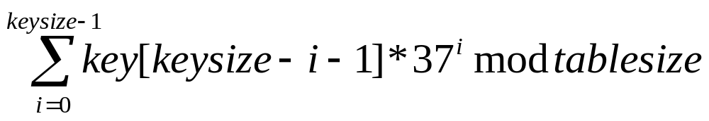
Horner’s Rule
Horner’s rule:
Another hash function proposed by Horner and called Horner’s rule, has the formulation below:
This mechanism is better than the two former functions. If the strings are too long, it takes long for hash values to compute. Then a certain substring of the key may be used.

Slide 16
Hash Functions for Integer Keys
Truncation Method: Take the first few or last few characters or digits as the hash code. This method is easy and fast. e.g., Consider Example2, only a subset of the id digits can be used. If 3 high-order digits are used then a table of size 1000 can be created. Collisions?
Division Method: We map a key k into one of m slots by taking the remainder of k divided by m. Quite fast
e.g., k=34752 |1000 (maxItems = 1000)
34
______
752
That is the hash function is h(k) = k mod m

Slide 17
More Examples to Hash Functions…
Multiplication Method: Operates in two steps. First, we multiply the key, k by a constant in the range 0<A<1 and extract the fractional part. Then, we multiply this value by m and take the floor of the result.
That is the hash function is h(k) = ⎣m (k A mod 1) ⎦
e.g., k=123456, m=10000, and A = (√5-1)/2
h(k) = ⎣10000 * (123456* 0.61803… mod 1 ) ⎦
= ⎣10000 * 0.0041151…⎦
= ⎣41.151…⎦
= 41

Slide 18
More Examples to Hash Functions…
Midsquare Method: The key is multiplied by itself (squared) and then the middle few digits of the result are selected as the hash code.
e.g., k = 510324 k² = 260430584976
h(510324) = 058

Slide 19
More Examples to Hash Functions…
Key is partitioned or divided into several pieces. Pieces are operated upon in some way. Adding them together and taking the required number of digits as the hash code is one of the possibilities.
e.g., k = 510324
Folding method 1: 51
03
24
78 For m=1000, h(k) = 078
Folding method 2: Fold left and right sections 15
1 03 2 03
5 4 42
60

Slide 20
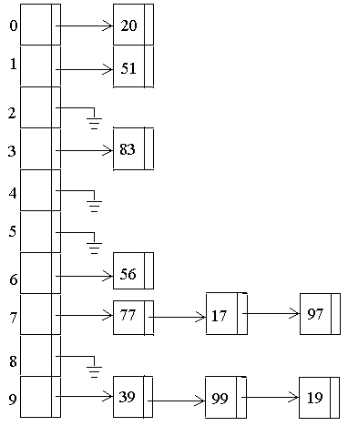
Separate Chaining

Slide 21
Open Addressing (Closed Hashing)
The hash table has a fixed size, M.
Any data point a_{k}∊ A under consideration is placed in the hash table.
The hash table cell, m, the data point a_{k} is placed is determined by the hash function, h, or m=h(a_{k}).
Since K>>M, sometimes collisions occur. To resolve the collisions, we use collision resolution strategies.

Slide 22
Analysis of Open Addressing
We will express the performance of hash tables in terms of the load factor a of the hash table.
Load Factor: The number that specifies how many elements of the hash table are full, or
a=n/m,
where
n is the number of occupied table cells, and
m is the table size.

Slide 23
Cost of Unsuccessful Search & Insert
In an unsuccessful search, at the end of the search, we find out that the key is not in the hash table once we find an empty table cell.
This is also what we do to insert a key into the hash table. We insert the key when we find an available space (unoccupied or empty table cell).
Hence, for both operations, we will attempt to find the expected number of checks (probes) we make before we find an available table cell.

Slide 24
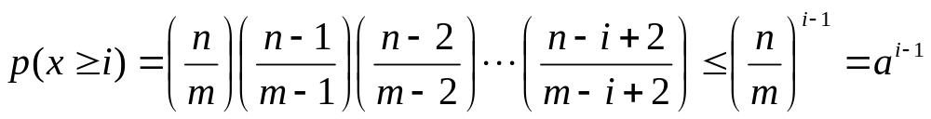
Cost of Unsuccessful Search & Insert
Assume X is an RV and represents the number of probes made in an unsuccessful search.
The probability that X is at least i (i.e., x ≥ i) probes before an empty slot is found is:

Slide 25
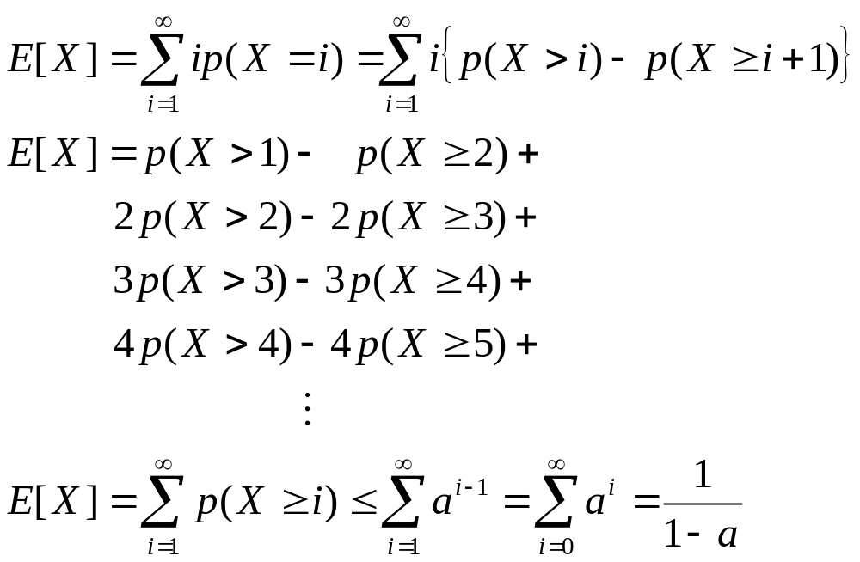
Cost of Unsuccessful Search & Insert
The expected number of probes made in an
unsuccessful search is at most:

Slide 26
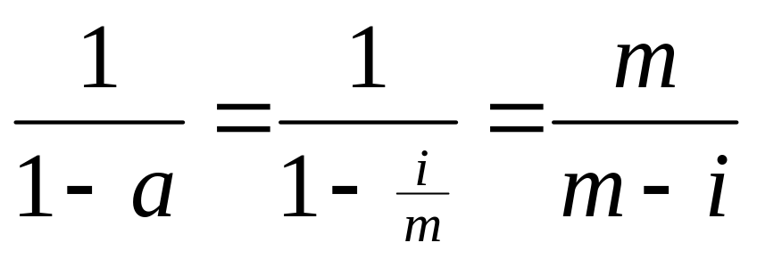
Cost of Successful Search
From the last slide we remember that the expected number of probes for the insertion of a key is at most 1/(1-a), a being the load factor. If, for instance, the key inserted is the (i+1)st key, then, the expected number of probes cannot exceed:

Slide 27
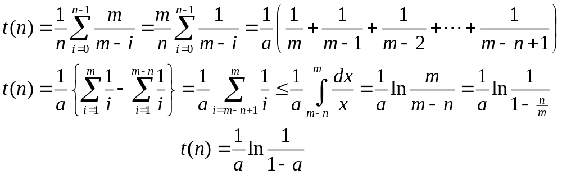
Cost of Successful Search
Using this info, the expected number of probes for a successful search can be found by averaging m/(m-i) for the (i+1)st key over n keys as follows:

Slide 28
Resolving Collisions in Hash Tables
Collision Resolving Strategies
  Linear Probing
  Quadratic Probing
  Double Hashing

Slide 29
Linear Probing
Given an ordinary hash function
h: A → {0,1,…, m-1}, the method of linear probing uses the hash function
h′ (a_{k},i ) = (h(a_{k}) + i ) mod m
where i is the number of collisions occurred for
the current key.

Slide 30
Linear Probing: Example
i\keys | Empty | 24 | 116 | 50 | 66 | 26 | 259 | 144 | 247 | 40 | 51
0 |  |  |  | 50 | 50 | 50 | 50 | 50 | 50 | 50 | 50
1 |  |  |  |  | 66 | 66 | 66 | 66 | 66 | 66 | 66
2 |  |  |  |  |  | 26 | 26 | 26 | 26 | 26 | 26
3 |  |  |  |  |  |  | 259 | 259 | 259 | 259 | 259
4 |  |  |  |  |  |  |  | 144 | 144 | 144 | 144
5 |  |  |  |  |  |  |  |  | 247 | 247 | 247
6 |  |  |  |  |  |  |  |  |  | 40 | 40
7 |  |  |  |  |  |  |  |  |  |  | 51
8
9
10
11 |  | 24 | 24 | 24 | 24 | 24 | 24 | 24 | 24 | 24 | 24
12 |  |  | 116 | 116 | 116 | 116 | 116 | 116 | 116 | 116 | 116
CF |  | 0 | 0 | 2 | 0 | 2 | 4 | 3 | 5 | 5 | 8

Slide 31
Quadratic Probing
Quadratic probing: uses a hash function of the form
h′ (a_{k},i ) = (h(a_{k}) + c₁i + c₂ i² ) mod m
where
i is the number of collisions occurred for the current key, and
c_{i}s are the coefficients of the quadratic function.

Slide 32
Quadratic Probing: Example
i\keys | Empty | 24 | 116 | 50 | 66 | 26 | 259 | 144 | 247 | 40 | 51
0 |  |  |  |  |  | 26 | 26 | 26 | 26 | 26 | 26
1 |  |  |  |  | 66 | 66 | 66 | 66 | 66 | 66 | 66
2 |  |  |  | 50 | 50 | 50 | 50 | 50 | 50 | 50 | 50
3 |  |  |  |  |  |  | 259 | 259 | 259 | 259 | 259
4 |  |  |  |  |  |  |  |  | 247 | 247 | 247
5 |  |  |  |  |  |  |  | 144 | 144 | 144 | 144
6
7
8 |  |  |  |  |  |  |  |  |  |  | 51
9
10 |  |  |  |  |  |  |  |  |  | 40 | 40
11 |  | 24 | 24 | 24 | 24 | 24 | 24 | 24 | 24 | 24 | 24
12 |  |  | 116 | 116 | 116 | 116 | 116 | 116 | 116 | 116 | 116
CF |  | 0 | 0 | 2 | 0 | 0 | 2 | 2 | 2 | 3 | 3

Slide 33
Double Hashing
Double hashing: is one of the best methods available. It uses a hash function of the form
h′ (a_{k},i) = (h₁ (a_{k}) + i h₂ (a_{k})) mod m
where
i is the number of collisions occurred for the current key, and
h₂ (a_{k}) is the second hash function involved in case of a collision.

Slide 34
Selecting the second Hash Function
A popular form of the second hash function is:
h₂ (a_{k})= R – (a_{k} mod R)
where R is usually selected as the closest smaller prime number than the table size.
The reason for selecting R this way is to obtain any second hash value equally likely.

Slide 35
Double Hashing: Example
h2 (a_{k})=R – (a_{k} mod R); R=11
i\keys | Empty | 24 | 116 | 50 | 66 | 26 | 259 | 144 | 247 | 40 | 51
0 |  |  |  |  |  | 26 | 26 | 26 | 26 | 26 | 26
1 |  |  |  |  | 66 | 66 | 66 | 66 | 66 | 66 | 66
2
3 |  |  |  | 50 | 50 | 50 | 50 | 50 | 50 | 50 | 50
4 |  |  |  |  |  |  | 259 | 259 | 259 | 259 | 259
5 |  |  |  |  |  |  |  |  |  | 40 | 40
6 |  |  |  |  |  |  |  |  | 247 | 247 | 247
7 |  |  |  |  |  |  |  |  |  |  | 51
8 |  |  |  |  |  |  |  | 144 | 144 | 144 | 144
9
10
11 |  | 24 | 24 | 24 | 24 | 24 | 24 | 24 | 24 | 24 | 24
12 |  |  | 116 | 116 | 116 | 116 | 116 | 116 | 116 | 116 | 116
CF |  | 0 | 0 | 1 | 0 | 0 | 1 | 2 | 1 | 1 | 2
h₂(a_{k}) |  | --- | --- | 5 | --- | --- | 5 | 10 | 6 | 4 | 4

Slide 36
Rehashing
If more than half of the current hash table is loaded, a new and larger hash table is constructed.
All keys are placed in this new table using a new hash function.
This is called rehashing.
A typical example to the selection of the size of the new table is the first prime that is greater than two times the size of the current hash table.

